Slide 1
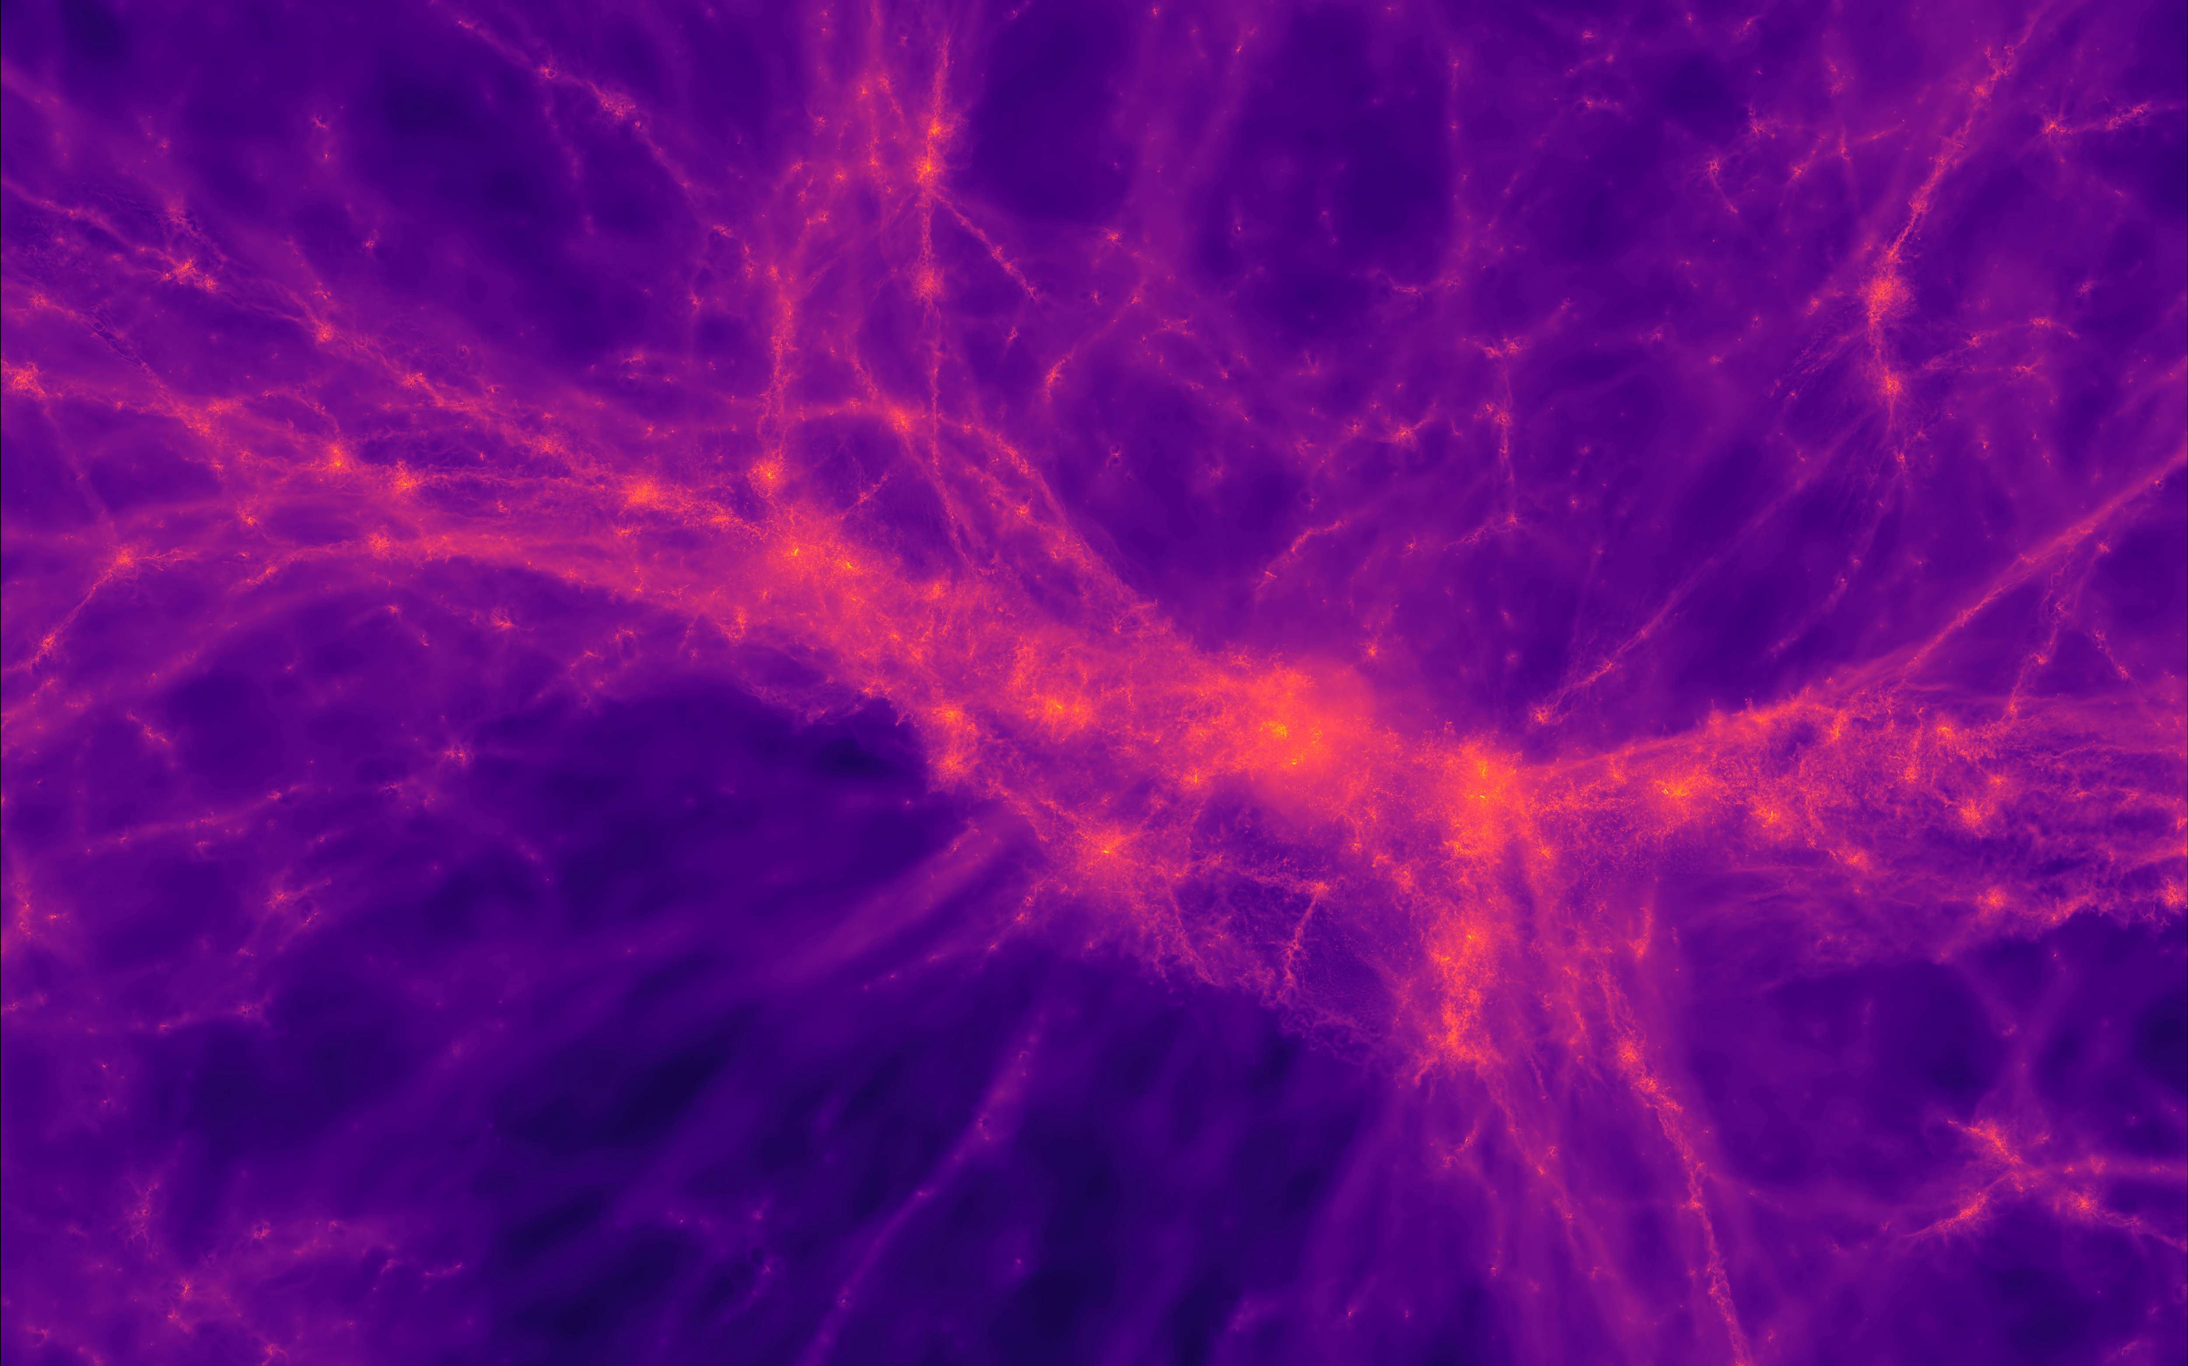
Detection of Dual Active Galactic Nuclei using Self-Supervised Active Learning Guided Detection System (SSALD)
Collaborators:
Diptarko Choudhury
Aniket Nath

Slide 2
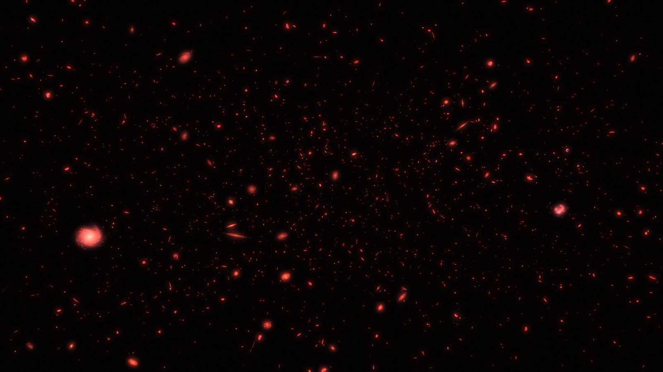
Systematic search for Dual Active Galactic Nuclei is a serendipitous process. It often involves image analysis in multiple wavelengths which is a tedious task. We aim to expedite the search process using Machine Learning. We will use the Sloan Digital Sky Survey (SDSS) which is a dataset obtained at optical wavelengths to implement our algorithm.

Slide 3
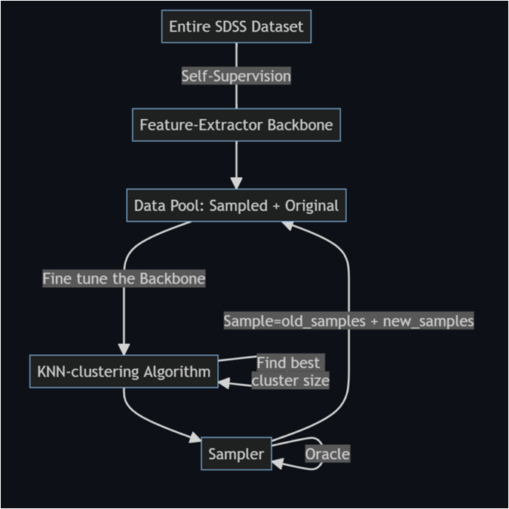
Training Algorithm

